Slide 1



Improvements to the ATLAS Real-Bogus Classifier
Josh Weston
Queen’s University Belfast
Notes:
• Hi, I’m Josh and I’m a 2nd year PhD Student in the supernova group at Queen’s University Belfast’s Astrophysic’s Research Programme. I’m funded through a programme called LINAS which aims to address implications of big data processing, AI and ML in wider society, with my focus in particular being on astronomy.
• From this I would like to talk to you today through some work I’ve recently carried out on the Real-Bogus classifier of the ATLAS sky survey.
• A little bit of background on me – I did my undergraduate at the University of Southampton and following this I went into working on credit risk models for a couple of years, and it was…well, I’m back in physics now to give you some idea. One of the things I picked up in this field was the importance of keeping machine learning models up to date; in some problems you may find a very static field of data and once you’ve developed a model to make predictions it will maintain a high level of accuracy throughout its lifetime. But there are data streams where the data will change over time, whether it be related to the financial behaviour of a society or the output from a telescope where optical hardware is being constantly updated and refined. I’d like to talk through why the periodic retraining of a model is useful in this context and the results we found when we attempted it.

Slide 2
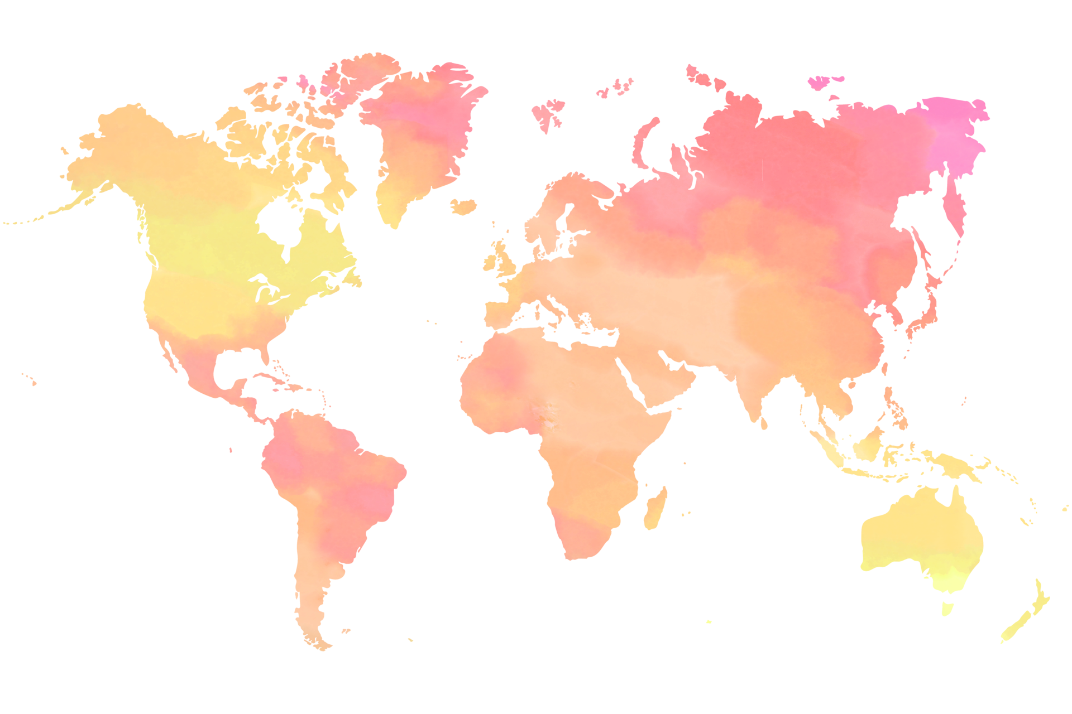

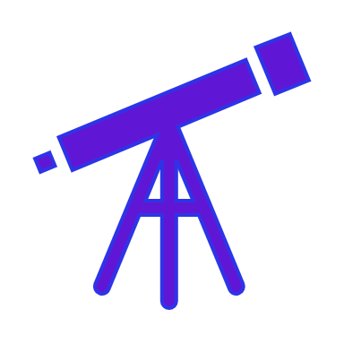

The ATLAS System
The Asteroid Terrestrial-impact Last Alert System (ATLAS) is an asteroid impact early warning system developed by the University of Hawaii and funded by NASA.
Survey has a 1-day cadence between ±50◦ and 2-day cadence in the polar region with repeat coverage 4 times a night.
Notes:
• So a little bit of information on ATLAS. ATLAS, or the Asteroid Terrestrial-impact Last Alert System is an asteroid impact early warning system developed by the University of Hawaii and funded by NASA.
• It consists of four wright-Schmidt telescopes that feed orange and cyan filter data to QUB for processing each night
• Haleakala went live in 2015, joined by neighbouring Mauna Loa in 2017, followed by two more at El Sauce and Sutherland in 2021 and 2022.
• The untimely volcanoing of Mauna Loa means we only have three operating telescopes: (attempting to fly up solar panels to supply power to the telescopes via helicopters, are funded and have an order with a company but will take a few months.)
• The survey has a 1-day cadence between 50 dec and a 2-day cadence at the poles with the ability to visit a region 4 times in a night.

Slide 3
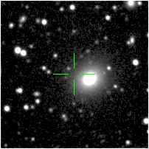
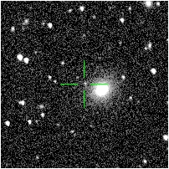
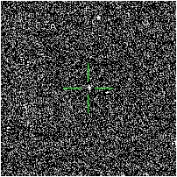
Difference Imaging
WALLPAPER
IMAGE
DIFFERENCE
Notes:
• So what do we do with this data? Well we detect transients via the large-scale cosmic spot the difference of Difference Imaging.
• We have a reference wallpaper of the ATLAS sky which we rebuild annually.

Slide 4
Difference Imaging
WALLPAPER
IMAGE
DIFFERENCE
Notes:
• Over the course of the survey lifetime we periodically return to given patches of sky and take additional images.

Slide 5
Difference Imaging
WALLPAPER
IMAGE
IMAGE
DIFFERENCE
Notes:
• If we subtract the first image from the second we can see the changes in brightness – and see whether there’s something there that wasn’t there before.
• Detections could be any number of real astronomical objects, moving across the sky like asteroids or changing their brightness like supernovae. This detection is demonstrably a real one with two clear images and an object that wasn’t there previously.

Slide 6
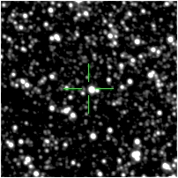
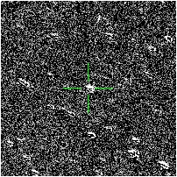
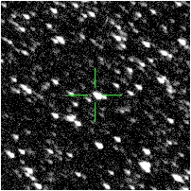
Difference Imaging
WALLPAPER
IMAGE
IMAGE
DIFFERENCE
Notes:
• But they could also be due to errors in the instrument, maybe the image we took was smudged or the subtraction wasn’t as clean as we’d like. We therefore need human scanners or annotators to look at each of these difference images to make sure it’s a real object. You can see here the image is quite smudged and as such the difference image has a number of artefacts.
• This image-taking happens once every 30 seconds over four telescopes on a 10k x 10k frame, with these images here being 400 odd pixels – to give you an idea of the problem we face every night!

Slide 7
The Real-Bogus Problem
Growing scope and increasing cadence of sky surveys generates a growing number of transient detections.
Filtering required via ML to reduce the number of detections humans are required to scan.
Techniques applied today will be applied to future surveys tomorrow!
Notes:
• There are tens of thousands of detections every night, and though we can filter some of the obviously bad ones out, we need to use machine learning models to catch the likeliest candidates.
• Humans will look at objects the model is happiest with to confirm them – but we’re only studying a few hundred instead of a few thousand. The trick is getting the model to show us the right ones!
• And this problem is going to grow as future surveys with bigger, deeper fields and shorter cadences come online like LSST. If we have a model now that only thinks 1 in 20 bogus detections are real, that’s manageable when we are dealing with only a few hundred bogus detections a night. But say the successor to such a survey is dealing with thousands of bogus detections, then we’re talking about humans having to go through hundreds a day – and that’s time you could better spend on research, or playing games on your phone. So it’s important that we constantly revisit this problem as our surveys grow.

Slide 8
The ATLAS Classifier
(20,20,1)
Conv2D
(2x2 kernel, 16 filters, ReLU Activation)
MaxPooling
(2x2)
ATLAS utilizes a Convolutional Neural Network (CNN) as its real-bogus classifier.
Input is a 20x20 pixel grayscale image centered on the detection. Output is a score between 0 (likely to be a Bogus detection) and 1 (likely to be a Real detection.
CNNs best suited for image classification tasks owing to their ability to discern physical features.
Conv2D
(2x2 kernel, 32 filters, ReLU Activation)
MaxPooling
(2x2)
Conv2D
(2x2 kernel, 64 filters, ReLU Activation)
MaxPooling
(2x2)
Flattening
Dropout
(30% Dropout Rate)
Dense Layer
(500 ReLU)
Dropout
(40% Dropout Rate)
Dense Output
(Softmax)
Notes:
• The Real-Bogus classifier we use in ATLAS is a Convolutional Neural Network. I could spend a whole talk explaining what the model does but in summary we use three successive convolutional and max pooling layers prior to flattening, dropping out and feeding features into a dense layer prior to real-bogus classification.
• Some justification about why we use a CNN – while the features extracted get more complex and less interpretable as we add more convolutional layers, they make CNNs best suited for image recognition tasks in their ability to discern structure and local correlations in the image at different scales.

Slide 9
The Real-Bogus Factor
We set a score threshold so scanners only need to look at objects above a certain score limit.
Catch n% of real objects
False Positive Rate (FPR) – percentage of bogus objects classed as Real.
Missed Detection Rate (MDR) – percentage of real objects classed as Bogus.
Count
Score
Notes:
• The aim of the model is to separate the real objects from the bogus objects. If the model gives them a low score they’re likely to be bogus detections, and if they have a high score they’re likely to be real. We pass on any object with a score above a certain threshold for humans to look at – ideally this is set so that we keep as few bogus detections as possible, while keeping as many real ones as possible.
• If we set it too low we give ourselves too much to look at that’s false, and our false positive rate – i.e. the percentage of bogus objects that are passed to scanners – goes up. If we set it too high our missed detection rate, or the percentage of real objects the model classes as bogus, increases.

Slide 10
The Real-Bogus Factor
We set a score threshold so scanners only need to look at objects above a certain score limit.
Catch n% of real objects
False Positive Rate (FPR) – percentage of bogus objects classed as Real.
Missed Detection Rate (MDR) – percentage of real objects classed as Bogus.
Count
Score
Notes:
• The better the model we train, the better the Real and Bogus populations are separated, and less time is wasted by annotators sorting through detections above the score threshold.

Slide 11
The Real-Bogus Factor
Catch n% of real objects
False Positive Rate (FPR) – percentage of bogus objects classed as Real.
Missed Detection Rate (MDR) – percentage of real objects classed as Bogus.
Count
We refer to FPR as the False Positive Rate corresponding to an MDR of 1.00%.
Score
Notes:
• It’s generally useful to consider the threshold as being set by your FPR and MDR. We want to set this threshold to provide an expected rate of False Positives and Missed Detections.
• In the context of this talk in particular, to reduce the time spent by human annotators, we want to shrink the false positive rate and so that’s the metric we’ll be focusing on. We fix our MDR to 1.00% when examining model performance and inspect the corresponding false positive rate.

Slide 12

Retraining a Classifier
Hardware changes over time impact the data collected by the telescope.
Refinement of the data occurs over time via improvements to image quality and human scanning growing the training sets.
HKO
MLO
MLO
STH
CHL
Notes:
• We previously had two neural networks trained for our Haleakala and Mauna Loa telescopes, and as our Chilean and South African telescopes came online we expanded the use of the Mauna Loa model to include these.
• The issue with this is that telescopes aren’t created equal, even if we try to make them as similar as possible. A model trained on one telescope’s data might not be great at parsing the data generated by another. To add to this, like most technology, telescopes change over time – CCD detectors have changed, optics have changed - e.g. corrector changes - and improvements to automated focus tracking all of which effect the PSF size. All telescopes, since initial live, all have had changes along these lines.
• Another change to account for is the refinement of our datasets over time. The more human scanning that takes place the greater the number of overruled classifier decisions we have, and the better the opportunity for a model to learn from its mistakes.

Slide 13
Retraining a Classifier
Build a 1:3 ratio of real to bogus detections for each training set (~1,300,000 detections total).
Select 5 orange nights and 5 cyan nights to pull known real objects (asteroids), and 200 nights for bogus objects. Augment the dataset with promoted goods.
MLO
HKO
STH
CHL
Notes:
• We started using the CNNs in late 2018 and retrained two years later in 2020 so we're well overdue a retrain. On top of that we could do with building some bespoke classifiers for the CHL and STH telescopes for which we should gain a significant improvement in quality.
• To begin with we select a ratio for real to bogus detections of 1:3 for our training and testing sets. This ratio addresses the inherent class imbalance while also making sure the classifier has enough real detections to learn from. This kind of imbalance also provides a robustness against false positives; we want to lean our model against providing too many false positives so we provide it with more bogus examples so it can learn to be more cautious with its predictions. We select five nights of orange filter data and five of cyan between May and October 2022 from which to pull known good objects - i.e. known asteroids - as the bulk of our real data, which we augment with objects in the good list which have been promoted to good by human scanning. Then from that same period we pull 200 nights worth of bogus detections which gives us about 1.3 million detections overall for each set.
• Using our CNN architecture we train over 20 epochs, minimising the loss function each time and selecting the optimal iteration at the end.

Slide 14
FPR = 2.97%
FPR = 2.67%
FPR = 5.79%
FPR = 1.11%
FPR = 0.86%
FPR = 1.50%
Notes:
• We plot the false positive rate against the missed detection rate by shifting around the RB threshold mentioned earlier and seeing how the two values change. If we fix the MDR to 1% as before we see for Haleakala a decrease in false positives from 2.97% to 1.11%, which is a pretty good improvement. Haleakala is the only operating telescope to have a new and old unique classifier so it's worth playing around with this a bit - if we try the new classifier on the training data for the older model the FPR is 7.5% versus the old model's 4.16%, which is what we'd expect if the telescope data behaviour has changed.
• Looking at the brand new classifier performance against the old MLO classifier CHL sees an improvement from 5.8 to 1.5, and STH from 2.67 to 0.86.

Slide 15
FPR = 2.97%
FPR = 2.67%
FPR = 5.79%
FPR = 1.11%
FPR = 0.86%
FPR = 1.50%
Notes:
• The aim of retraining is to reduce the number of bogus detections that the classifier passes along to human scanners while maintaining the same rate of real objects captured. If we look at the distributions of the two classes by score, old on the top and new on the bottom, we do see a marked improvement in the separation between them. For the example of CHL, whose FPR has reduced by a factor of 4: for the 1.14 million bogus detections in our dataset, 66,000 would have been passed on to human scanning. That number has now been reduced to about 17,000.

Slide 16
Image Size Adjustments
Smaller image sizes may reduce computational time and improve Real feature selection.
Shrink stamp size from 20x20 to 10x10 (x4 smaller).
Notes:
• It’s also worth considering further improvements, such as those that can be made to the input images. Increasing the size of the data increases the computational expense but decreasing it might improve our efficiency.
• The reduction may reduce the complexity of the model image, decreasing the risk of overfitting and allowing the classifiers to more easily generalize to new data.
• We shrunk the stamp sizes to 10x10 pixels and ran them through the same model architecture as before.

Slide 17
FPR = 2.42%
FPR = 2.79%
FPR = 4.05%
Notes:
• What we see is that the FPRs are better than those of our own model but not as good as the 20x20 pixel data.
• And this is mainly because successive convolutions and pooling layers further reduce the dimensionality of existing features. Your input shrinks with each successive layer, so by the time you’re getting to your output layer your input for 10x10 pixel images is tiny and there’s not much for a model to use.
• There’s also a potential loss of Bogus Features as a result of image cropping. Our training sets contain a lot more bogus detections, and if you think back to our input difference images there are a lot of different artefacts that can indicate bogus features, but maybe fewer in that centre of the image that can indicate Real features. If we crop out large sections of our input, there are less features for the CNN to learn from. But onwards and upwards!

Slide 18
Dealing with Bad Pixels
Every CCD has bad pixels. The general question is how to deal with them.
Previously we gave them a “Magic Number” of minus Pi.
Concerns about the impact this may have when images are normalized have resulted in the replacing of values with zero instead.
Notes:
• Another thing we can try – bad pixels. Every CCD has them, the question is how we deal with them.
• When we receive our input images bad pixels are marked with a Magic Number of minus ten thousand Pi.
• But we normalise our image before we feed it to the classifier, and these high negative values have probably been throwing things off a bit. So what we’ve done instead is replace these values with zero, and the results are quite impressive.

Slide 19
FPR = 0.72%
FPR = 0.60%
FPR = 0.79%
Notes:
• Compared to our initial retrained FPRs of 1.11, 0.86, and 1.5% for the telescopes we’re now seeing even greater decreases and almost a tendence to performance parity for each classifier.
• This surprised us – we did not suspect such a significant drop. But going forward we’re definitely going to correct these numbers to zero prior to normalisation and achieve a much better performance for it.

Slide 20
Model Comparisons
Classifier | Description | FPR (HKO Classifier)
D0 | Default Retrained | 1.11%
D1 | Two Conv Layers | 1.30%
D2 | One Conv Layer | 2.02%
D3 | No Conv Layers | 4.34%
MobileNet | [1] | 2.76%
LeNet-5 | [2] | 1.11%
Compare model performance on our final datasets to that of other CNNs.
Model achieves parity of FPR with well-known CNN architectures.
[1] Howard A. G., Zhu M., Chen B., Kalenichenko D., Wang W., Weyand T., An- dreetto M., Adam H., 2017, MobileNets: Efficient Convolutional Neural Networks for Mobile Vision Applications (arXiv:1704.04861)
[2] Lecun Y., Bottou L., Bengio Y., Haffner P., 1998, Proceedings of the IEEE, 86, 2278
Notes:
• One other thing we wanted to do was be able to justify the use of our model in comparison to others.
• To do this we took our datasets from the initial retraining and fed them through alternative model architectures; we tried fewer convolutional layers, alternate kernel sizes, and a few known architectures such as MobileNet.
• Our CNN outperforms almost all attempted alternatives on ATLAS data – reducing the number of convolutional layers saw a greater inability to discern features, while architectures such as MobileNet simply failed to extract features as well.
• The only model that could match our own CNN was LeNet-5, which was similarly trained on a 28x28 grayscale image set during its development, but it was a case of outperforming one telescope by a twentieth of a percentage point and underperforming in another by the same amount, so we elect to say the performance is comparative and stick with our in-house classifier.

Slide 21
FPR = 1.11%
FPR = 0.95%
FPR = 1.46%
Notes:
• The only model that could match our own CNN was LeNet-5, which was similarly trained on a 28x28 grayscale image set during its development.

Slide 22


Real-Term Impacts
CHL FPR has decreased from 5.97% to 0.79%.
Human annotators can reduce the time spent scanning by up to 90%!
Notes:
• Back to the real-terms impact of this. From our old model’s performance on the new unfixed data to the new model’s performance on that same fixed data we see for Chile a decrease in the FPR from 5.97% to 0.79%. That’s a 90% reduction in human scanning time for that telescope!
• We implemented the retrained classifiers with the new magic numbers in September on all three telescopes, and while we’re waiting a bit longer to get an idea of how much the workload has shrunk given weather and lunar phases, it is looking good.

Slide 23
One small thing…
 | KNOWN | UNKNOWN
GOODS | Promoted Goods, Rescued Goods, Asteroids | RB < 0.2 Detections
BADS | Promoted Bads
Detections classed as bad are those discarded by scanners and those below the threshold. Some below the threshold will be good!
Relevant features of this population may be ignored in training or treated negatively by the classifier.
Comparison of the old and new detection populations indicate the impact of this behaviour is small.
Notes:
• It's worth also discussing some issues with our datasets before we wrap up. Our datasets consist of four sub-populations: of good objects, we have known real objects identified by ephemeris checks and objects promoted to good by human scanning. Of bad objects, we have objects rejected by the real-bogus threshold and objects rejected by human scanners. What we're ignoring here is those good objects below the RB threshold. Some may be rescued manually but there's likely a number of objects in our bad list that shouldn't be there. Objects promoted to good via scanning are pre-selected based on the RB threshold, meaning that real objects the model discards are less likely to be promoted, and as such any relevant features will not be weighed heavily by our new classifiers. The impact of this is doubled when we consider those ignored real objects will instead be in our bad population, where new classifiers may learn to treat these features negatively rather than ignore them.
• If we trial the classifiers on the 27,000 objects in the good list 112 are reclassed as bogus. Ignoring objects classified by the old MLO model, 14 of these are significantly misclassed - a sort of nebulous "this is no doubt a human would class this as real" definition. Five of these were actually misclassed by the old classifiers and rescued by humans following discoveries by other surveys, so we find 9 real problem objects. Quite low. Of a sample of 20,000 bogus objects 215 are promoted to scanning, eight of which are given a score above 0.9. Two of these are actually real and the other six are due to residuals from bright star subtractions in the difference imaging, so that may be an avenue for improvement down the line.

Slide 24

Conclusions & Considerations…
Evolving data: Retraining on recent data following changes to optical hardware can yield strong improvements to performance.
Information size: While a larger image size reduces computational efficiency, a smaller image size reduces the number of useful features.
Input adjustments: Masking of ‘Magic Numbers’ in the image sets improves the performance further.
Architecture adjustments: Comparison to other CNN architectures indicates the ATLAS CNN suite maintains a competitive performance.
jweston04@qub.ac.uk
Notes:
• Talk through, very simple

